Slide 1
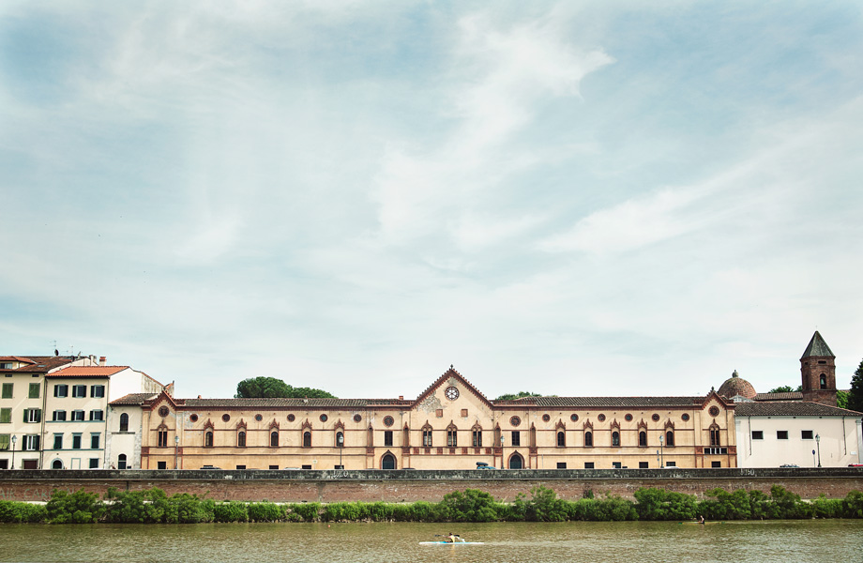
“Future research needs in terms of statistical methodologies and new data”
Early reflection paper to define future pathways for the new EU Framework Programme
Tommaso Rondinella (Istat)

Slide 2
Rationale and background
ICT, digitalization, web 2.0, AI → Data deluge(and fake news)
→ Data economy
→ Big data
→ Modernization of Official Statistics
Official statistics is called to move up the knowledge pyramid

Slide 3
Rationale and background
Challenges for official statistics 1/2
Other producers
Complexity of modern societies and multidimensional phenomena
New and more specific knowledge needs:
thematic nature,
territorial detail,
type of information produced.
“All data evolution”, using data from all traditional and new sources
new methodologies
experimental statistics
quality standards

Slide 4
Rationale and background
Challenges for official statistics 2/2
Evidence-based policy making:
Attention to relevance
Innovative frameworks of analysis
Extended macroeconomic and microeconomic models
“statistical service” to support citizens and policy makers in data use
Training and promotion of a statistical culture
Research (independence vs. relevance)

Slide 5
Towards the 9th Framework Programme
Source:
EC COM(2018) 321 final.
A Modern Budget for a Union that Protects, Empowers and Defends. The Multiannual Financial Framework for 2021-2027

Slide 6
The themes
New data
Methodologies for new sources
Assessment capacity
Skills and competence development
Building a data-friendly environment

Slide 7
The themes: NEW DATA
FP9 should call for:
coverage of all SDGs targets through innovation;
better statistics for the globalized world;
timely social and environmental statistics;
the extension of national accounts to social and environmental issues;
a higher “resolution” of data for evidence-based policy.

Slide 8
The themes: METHODOLOGIES FOR NEW SOURCES
FP9 should call for:
research on big data, either being (UNECE, 2013):
Traditional business systems,
Machine-generated data,
Human-sourced information;
evaluation of quality issues for new sources;
Best practices for the use of administrative data;
“all-data evolution”: the integration of sources;
experimental statistics;
“smart stats”;
statistical methods to guarantee comparability over time and space.

Slide 9
The themes: ASSESSMENT CAPACITY
FP9 should call for:
evaluation tools easily accessible to administrators and stakeholders;
data integration in statistical modelling;
extended macroeconomic models;
now-casting methods that can be applied to well-being and SD;
information and tools at local level.

Slide 10
The themes: SKILLS AND COMPETENCE DEVELOPMENT
FP9 should call for:
statistical literacy through formal and informal education at all educational levels;
public campaigns for citizens at large;
communication tools for maximizing data impact.

Slide 11
The themes: BUILDING A DATA-FRIENDLY ENVIRONMENT
FP9 should call for:
open data to become a minimum standard for private and public institutions;
access to microdata;
facilitate e-infrastructures and horizontal data services;
move towards a data economy.

Slide 12
Thank you for your kind attention!
rondinella@istat.it
www. makswell.eu

Slide 13
Objectives
Moon-shot objectives:
Quality and timely data for SDGs.
Full comparability in time and space.
Evidence-based policy tools at local levels.
Open data for the whole public administration.
Data economy.
Statistics as a service.
Integration of multiple data sources and e-infrastructures.
Intermediary objectives:
New data sources for SDGs.
Methodologies for big data, including SAEs.
Coordinating sources on populations not easily represented by the new data.
Shared big data quality framework.
Enhanced integration.
Extended policy tools for social and environmental issues.
Extension of statistical literacy through formal and informal education.
Improved communication techniques.
Spreading of “smart stats” experiences.
Continuous improvements:
Increase trust in official statistics.
Minimize statistical burden of respondents.
Increase efficiency in data production and dissemination.

